Slide 1
SMART AND SECURE DOOR ALERT

Slide 2
PROJECT GOALS
To Enhance the security.
To develop the sequential Timing.
To see the live streaming video Automatically.

Slide 3
Description about Sensors(IOT):
A sensor is a device that detects and responds to some type of input from the physical environment. The specific input could be light, heat, motion, moisture, pressure, or any one of a great number of other environmental phenomena. The output is generally a signal that is converted to human-readable display at the sensor location or transmitted electronically over a network for reading or further processing.
A kind of motion sensor that detects any kind of activity on your property and trigger instant mobile alerts.
Motion sensors in various systems including home security lights, automatic doors and bathroom fixtures typically send out some type of energy, such as microwaves, ultrasonic waves or light beams and detect when the flow of energy is interrupted by something entering its path.

Slide 4
Progress of the Project
Software downloaded and installed.
Once you understand the Push Notification sample, you will need your Azure Notification hub access keys
Update the sample projects with your own keys
Run the Client App and test that the keys worked by using
Find and Pin the App in your Start menu
Deploy the IoT Doorbell modified Push Button App code the Pi
Push the button
Get Notifications
Toast
Tile
We have Assembled the components in detail study of the micro controller.
Indetail study of the algorithm and program.

Slide 5
Software Requirement Specification

Slide 6
Software Requirements Specification
A software requirements specification (SRS) is a description of a software system to be developed, laying out functional and non-functional requirements, and may include a set of use cases that describe interactions the users will have with the software.
The purpose of this document is to give a detailed description of the requirements for the “Smart Doorbell Project” software. It will illustrate the purpose and complete declaration for the development of system. It will also explain system constraints, interface and interactions with other external applications.

Slide 7
Component of SRS
External Interface requirement
User Interfaces
Hardware Interfaces
Software Interfaces
Communications Interfaces

Slide 8
Functional Requirements
Functional Requirement 1.1
TITLE:Doorbell-Presses the doorbell switch
Functional Requirement 1.2
TITLE:Camera-Imaging
Functional Requirement1.3
TITLE:Smartphone-Message and email notification

Slide 9
Non-Functional Requirements
Performance:
The system performs efficiently everywhere if there is presence of Internet.If the speed of internet is less then we may get notification late i.e not at the time of delivery.
Reliability:
System is not reliable only in absence of Internet.It is not reliable if the person is unable to get the notification at correct time.
Availability:
Resources are easily available i.e they are not costly and can be easily bought.
Security:
The system is secure and there is no issues regarding it.
Maintainability:
Easy to maintain.
Portability:
Devices are portable because the connections can be easily unplugged and carried to different places.The output device smartphone is the best portable device.

Slide 10
Design Modules
Interaction between visitor and the device:Presssing the doorbell calls this function.
Sending signal from doorbell to microcontroller:The sound or motion is converted to electrical signal.
Displaying the message in LCD:Message displayed on LCD
Sending notification:Forwards message to smartphone.

Slide 11
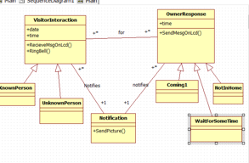
Class digram:

Slide 12
In software engineering, a class diagram in the Unified Modeling Language (UML) is a type of static structure.
Diagram describes the structure of a system by showing the system's classes, their attributes, operations (or methods), and the relationships among objects.

Slide 13
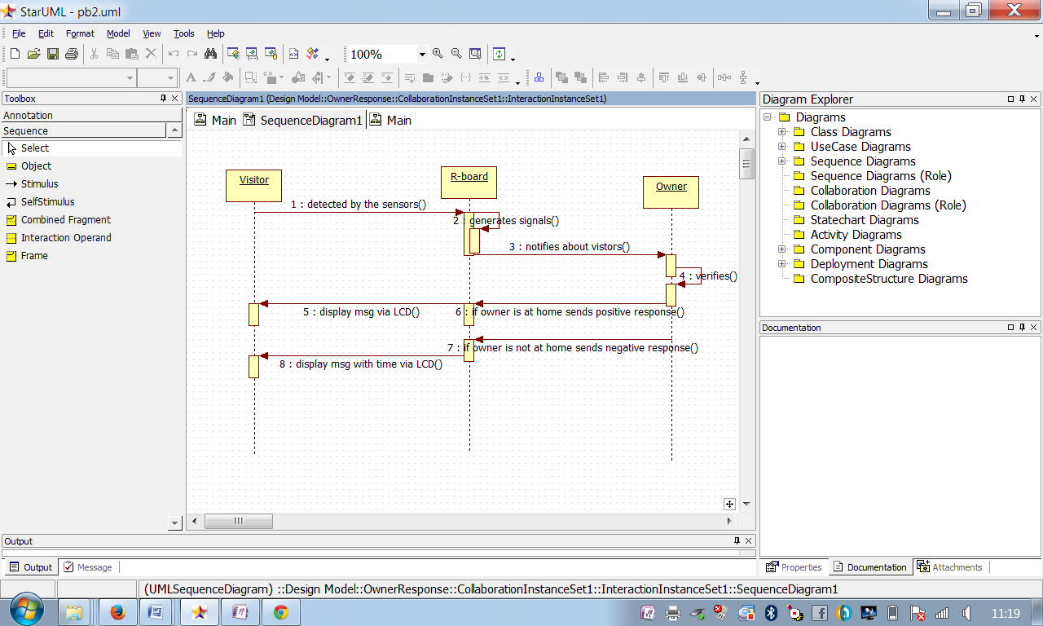
Sequence Diagram:

Slide 14
A Sequence diagram is an interaction diagram that shows how processes operate with one another and in what order.
A sequence diagram shows object interactions arranged in time sequence. It depicts the objects and classes involved in the scenario and the sequence of messages exchanged between the objects needed to carry out the functionality of the scenario.

Slide 15
Thank You

